Slide 1
An Introduction to Particle Systems
Dylan Carpenter (21982288)
Andrew Barwise (21253653)

Slide 2
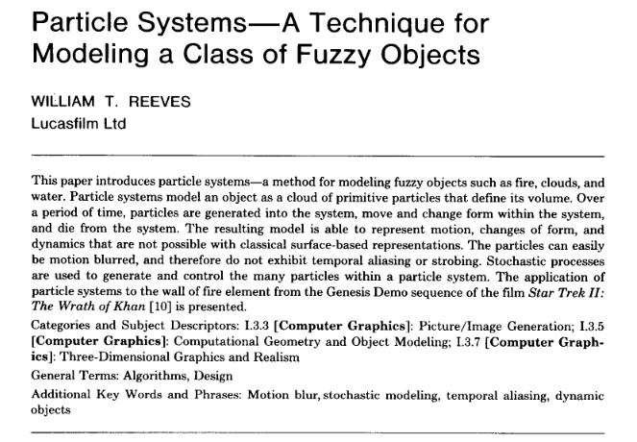

Slide 3
Basic Model of a Particle System
Particle generation
The number of particles generated strongly influences the density of the fuzzy object.
An equation is developed to generate new particles.
NewParts(f) = MeanParts(f) + Rand() * VarParts(f)
A simple linear system is used to allow the particle system to change its intensity as the program moves from frame to frame.
MeanParts(f) = InitialMeanParts + DeltaMeanParts * (f - f0)

Slide 4
Basic Model of a Particle System
Particle attributes
Any number of possible attributes could be used within a particle system to design a structure. Common attributes are:
Initial position
Initial velocity
Initial size
Initial colour
Initial transparency
Shape
Lifetime

Slide 5
Basic Model of a Particle System
Particle dynamics
Individual particles must change over time in colour, transparency and size. It is essential that particles move from one frame to the next. Velocity vectors are used in conjunction with position vectors to allow particles to move between frames. Acceleration values are used to simulate gravity and allow particles to move in non linear lines.

Slide 6
Basic Model of a Particle System
Particle extinction
There are a few methods for determining the lifetime of a particle. One way is to have a limit on a particle’s lifetime that is measured by frames. Once a particle's lifetime reaches zero it is terminated.
Another way of ensuring a particle extinction is to track the distance of a particle and to kill it off when it moves beyond a specified distance from its parent particle system.

Slide 7
Basic Model of a Particle System
Particle rendering
The particles in our particle system are rendered as point light sources. The particles are slightly transparent. Being slightly transparent allows the avoidance of issues around clipping. Transparency also allows the particle colours to mix together.

Slide 8
Basic Model of a Particle System
Particle hierarchy
A model is designed so that within a particle system the particles are themselves particle systems. When the parent particle system is transformed so are its descendent particle systems and their particles. The number of new particle systems generated at a frame is based on the parents particle generation rate.
A tree data structure is used to represent hierarchy.

Slide 9
Tools and Resources
Python 3
Pyglet - opengl framework for drawing and rendering
FFMPEG
For video composition and manipulation
Original paper by WIlliam Reeves (ILM)
Reeves, W. T. (1983). Particle systems—a technique for modeling a class of fuzzy objects. ACM Transactions On Graphics (TOG), 2(2), 91-108.

Slide 10
Fireworks Using Reeves’ Particle Systems
Reeves implemented a fireworks simulation using the proposed particle system techniques.
The core particle system is the same, with enhancements to the control and variability of the system, as well as the rendering techniques used.
The following images are several overlayed fireworks included in the paper.

Slide 11
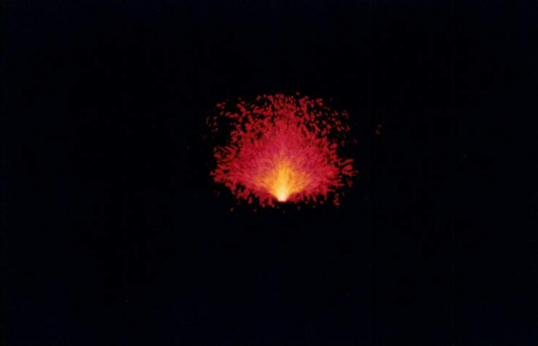
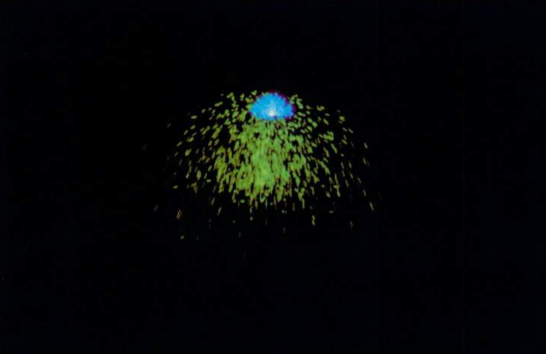
Pairs of fireworks. The first shows fireworks of different ages, the second shows different explosion powers

Slide 12
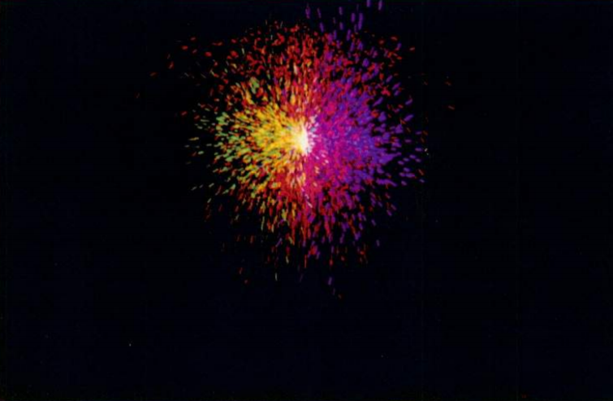
Over a dozen overlayed fireworks with varying colors and ejection angles

Slide 13
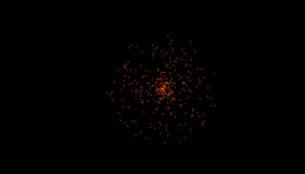
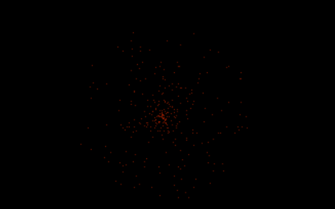
Our Fireworks

Slide 14
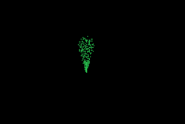
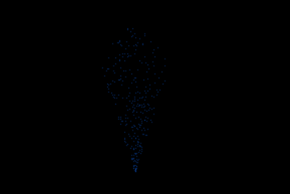
Our Fireworks

Slide 15
They Look… Interesting - Limitations
Reeves conducted his research at ILM; the leading effects studio at the time. We are students with sparse computer graphics experience.
Our limitations:
No vertex/fragment shaders
No motion blur (we have to plot points instead)
No antialiasing
Simulation resolution

Slide 16
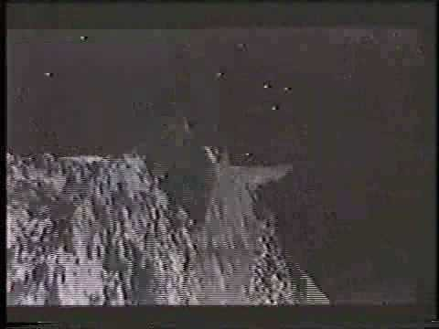
The Genesis Effect (Star Trek II: Wrath of Khan)

Slide 17
Our Simulation
Video time!
Notes:
Switch to video(s)

Slide 18
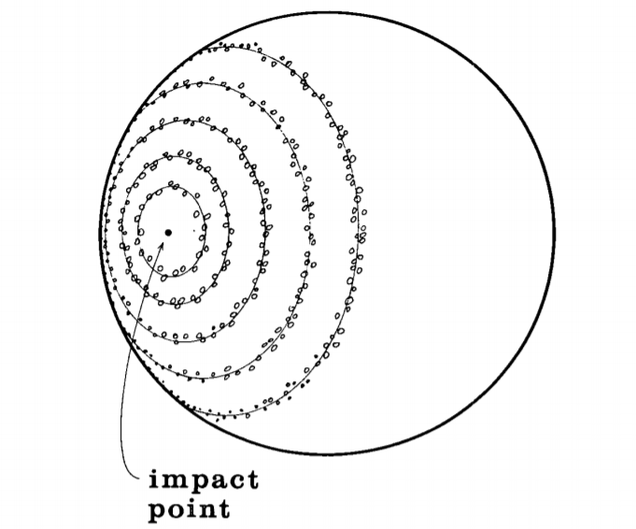
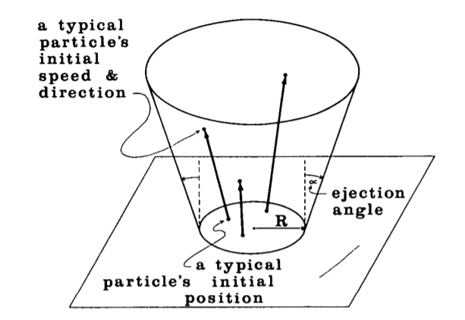
How its made
Two tiered particle system
Top level spawns particle systems across the surface
Second level spawns particles in place
Multiple Layers Composited (not in simulation)
Front, lighting, planet, back, stars etc.
All rendered separately then put together
Lots of variability
Large number of parameters that can be tuned
Particles and particle systems inherit parent properties with random variation
Many parameters can change gradually over time
Around 80000 particles and 200 particle systems
up to 750000 particles in close-ups (about 400 systems)

Slide 19
Performance Comparison
In 1983 computational power wasn’t quite what it is today!
Then, to render a single frame with 100000 particles took several minutes.
Our simulation rendered a single frame in approximately 1-2 seconds*. Not yet real time, but not far off.
*Using a 6-core, 12-thread CPU

Slide 20
Conclusion
Replicated the particle system proposed and used by Reeves
Used the particle system to simulate fireworks
Recreated the Genesis Effect

Slide 21
Future Work and Improvements
Improved rendering, graphics and camera movement
Particle System lighting/mesh interactions with planet
Lighting generated by the system
Visible effects of the particle system as it moves over planet
Simulation of planet regeneration
Performance improvements
Data structures used to store and manipulate particles
Compute Shaders, GPU use etc.

Slide 22
Questions?

